Slide 1

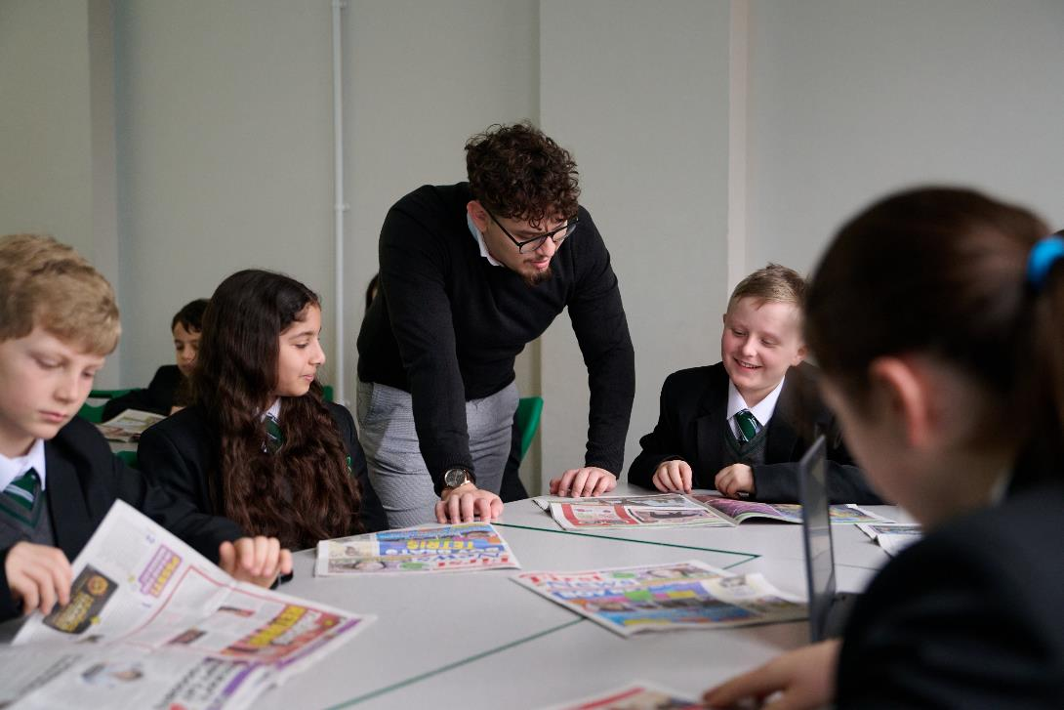
Your guide to:
Spotting fact, fiction, and spin in the news
This assembly connects to the
TeachKit: Media & Information Literacy Framework Domain: Being Informed.

Slide 2
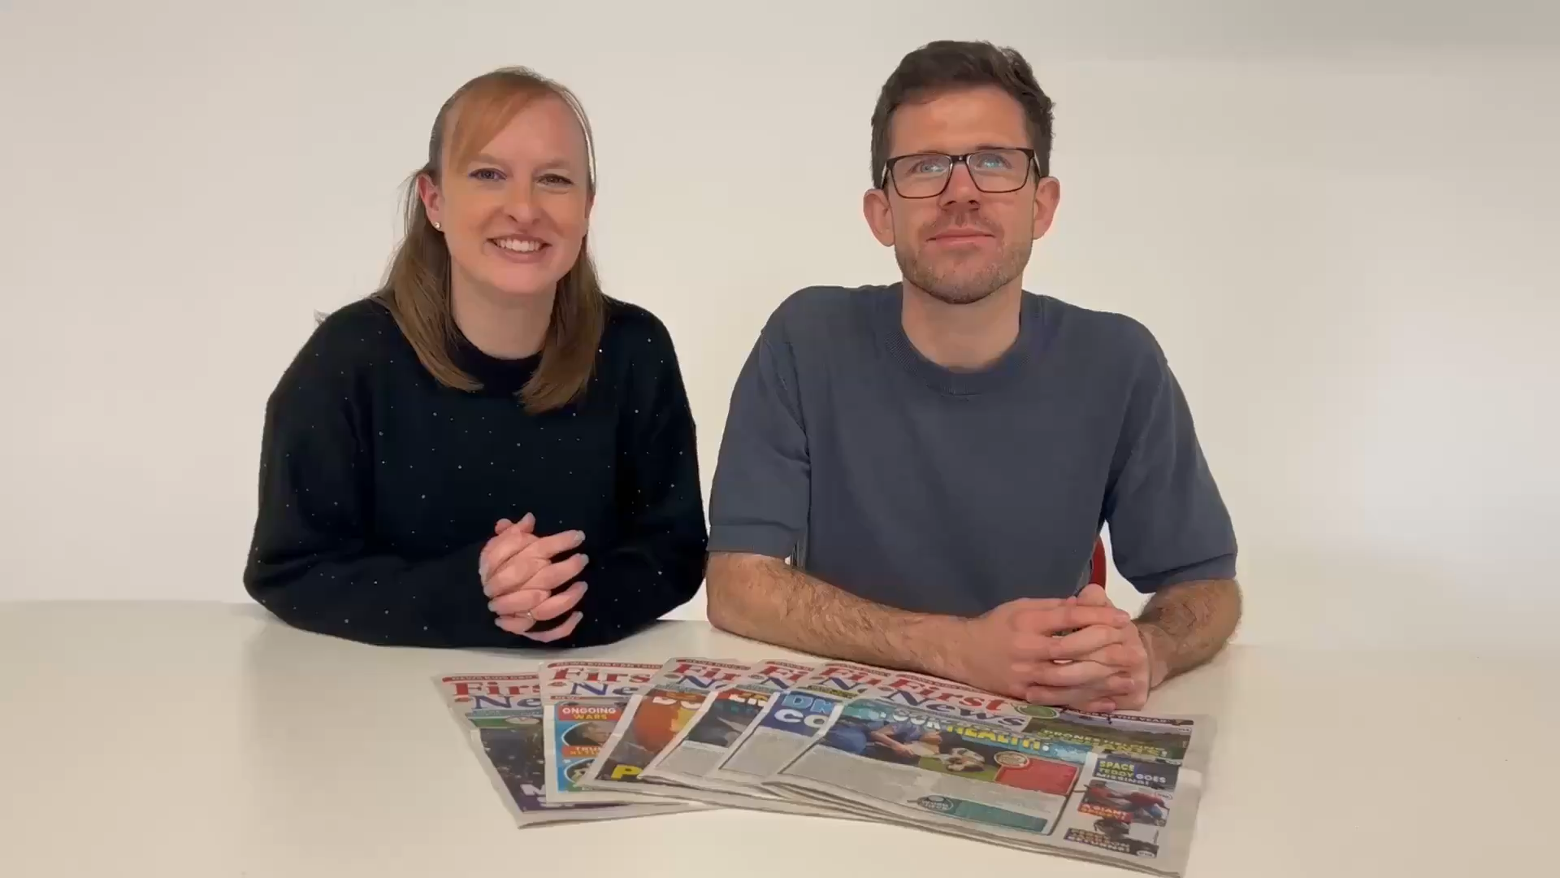
Hello,
we’re Hannah and Chris!

Slide 3
What is a fact?
FACT
Something true
Can be checked
FICTION
There is evidence

Slide 4

What is an opinion?
What someone thinks or believes
Might be different for other people
Can’t always be proven

Slide 5

What is spin?
Gives information in a way that makes you feel a certain way
Uses emotional words
Might omit facts
To achieve a specific purpose

Slide 6
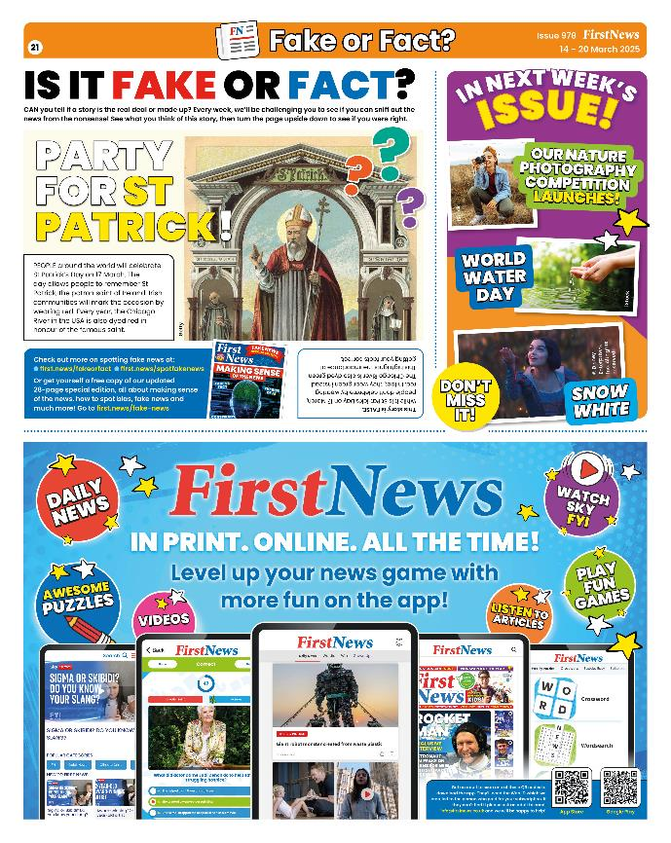
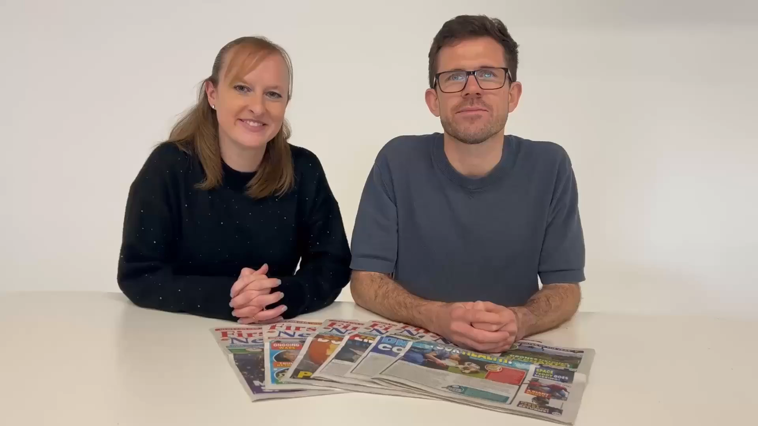
Checking the facts

Slide 7


If you're not sure if it's fact, opinion, or spin, ask yourself:
Could this be trying to make me a feel a certain way, or do something?
Is someone trying to change my mind?
Am I getting the full picture?
What is my current stance on this and how can I get more reliable information?

Slide 8

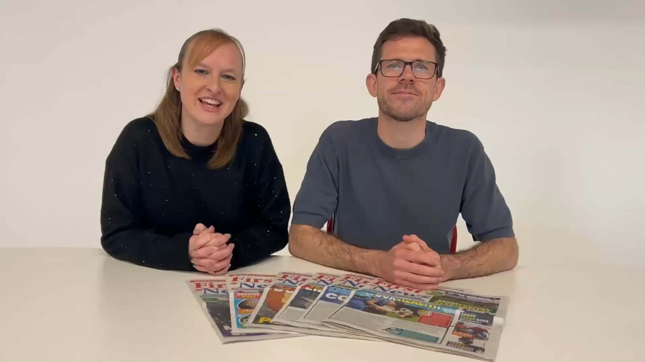
Thank you!

