Slide 14
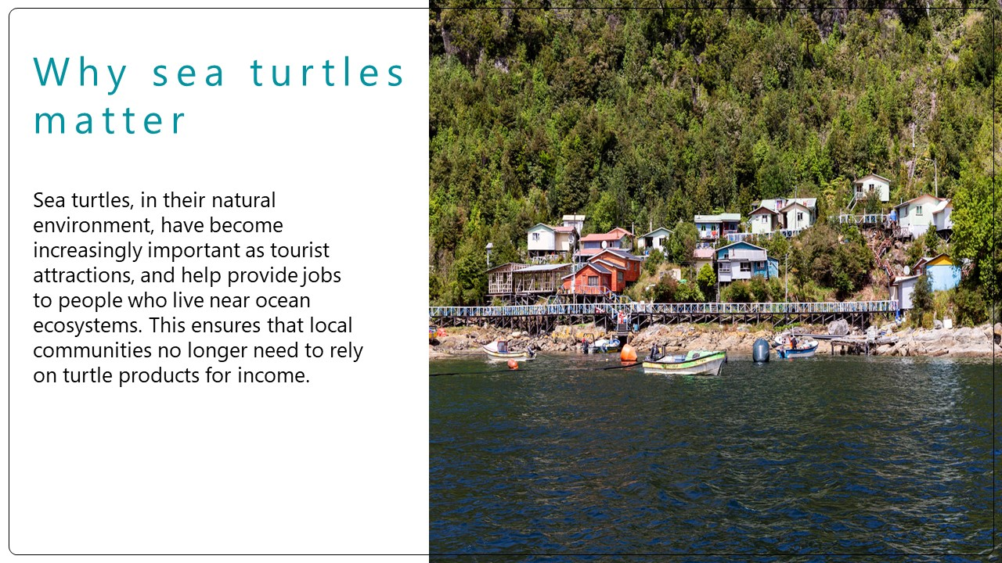

Slide 21
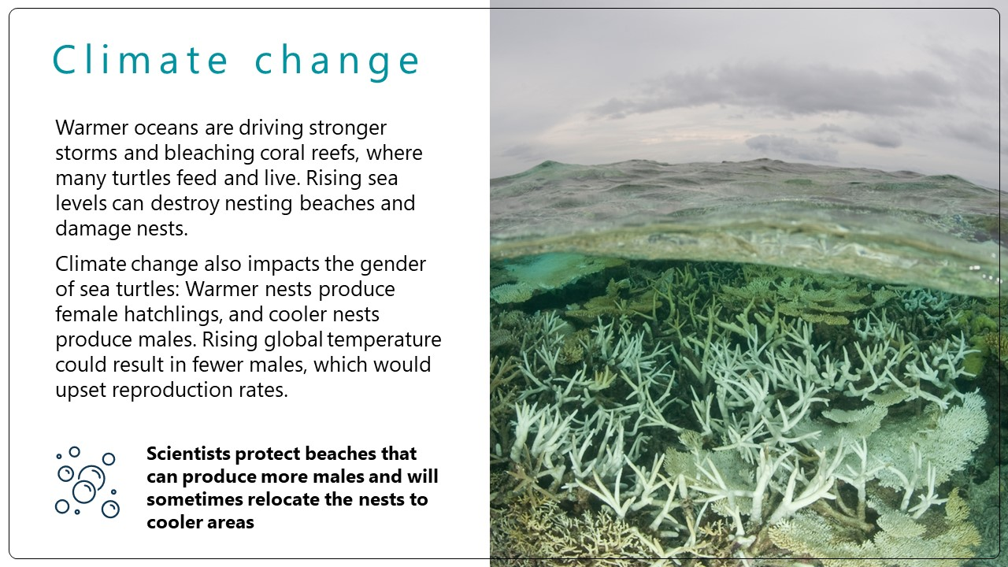

Slide 22
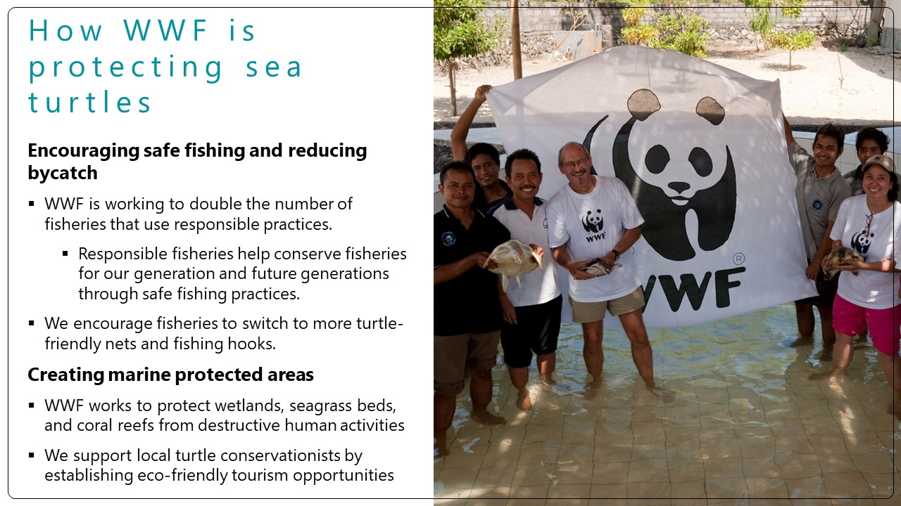

Slide 26
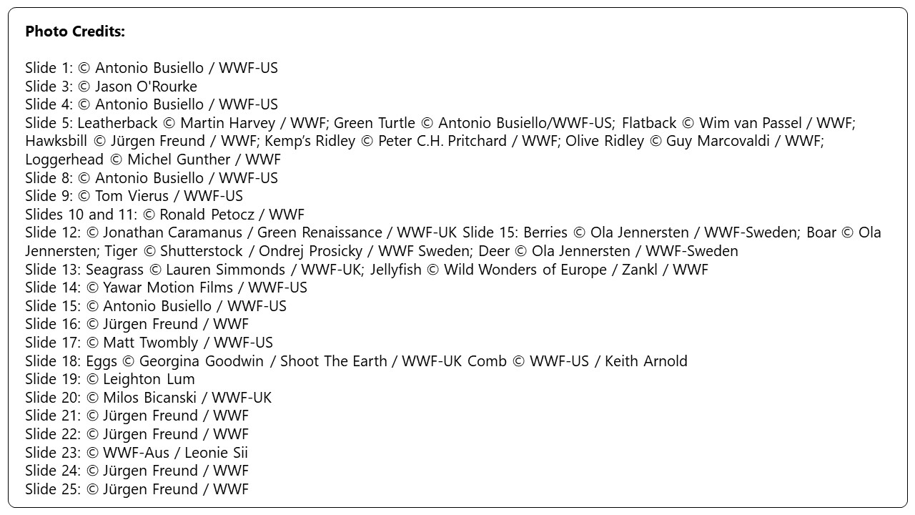

Slide 27
© 2023 WWF. All rights reserved by World Wildlife Fund, Inc. WWF® and ©1986 Panda Symbol are owned by WWF. All rights reserved.

