Slide 8
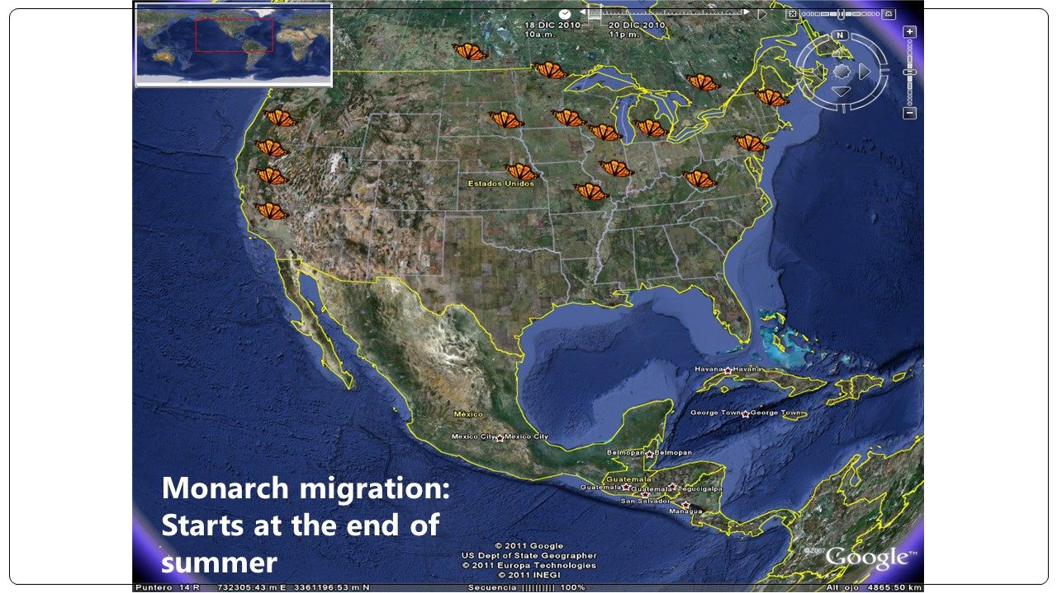

Slide 9
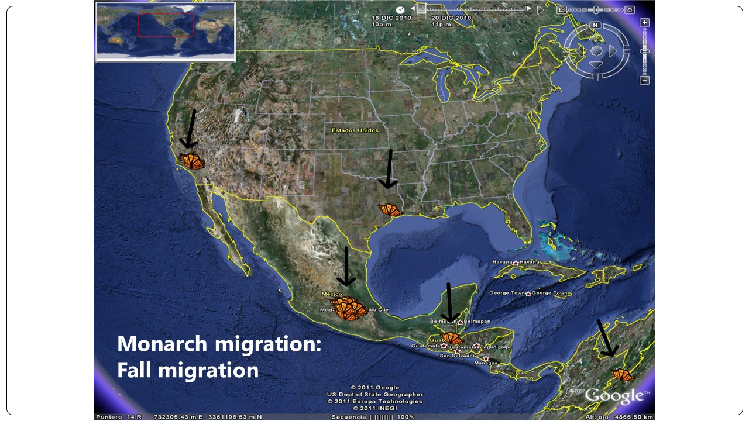

Slide 11
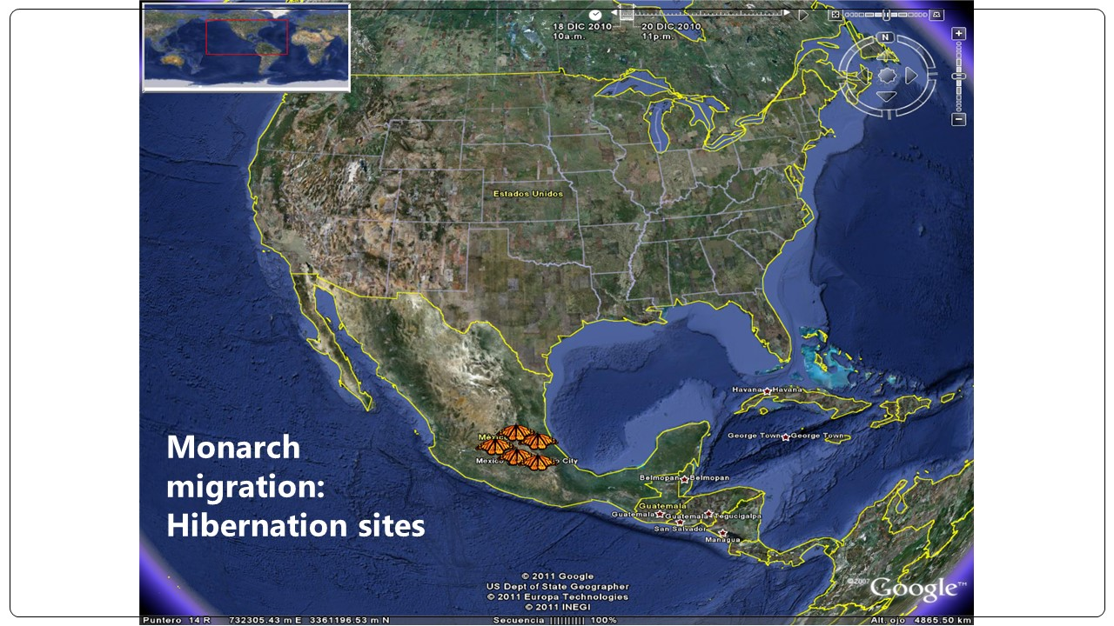

Slide 12
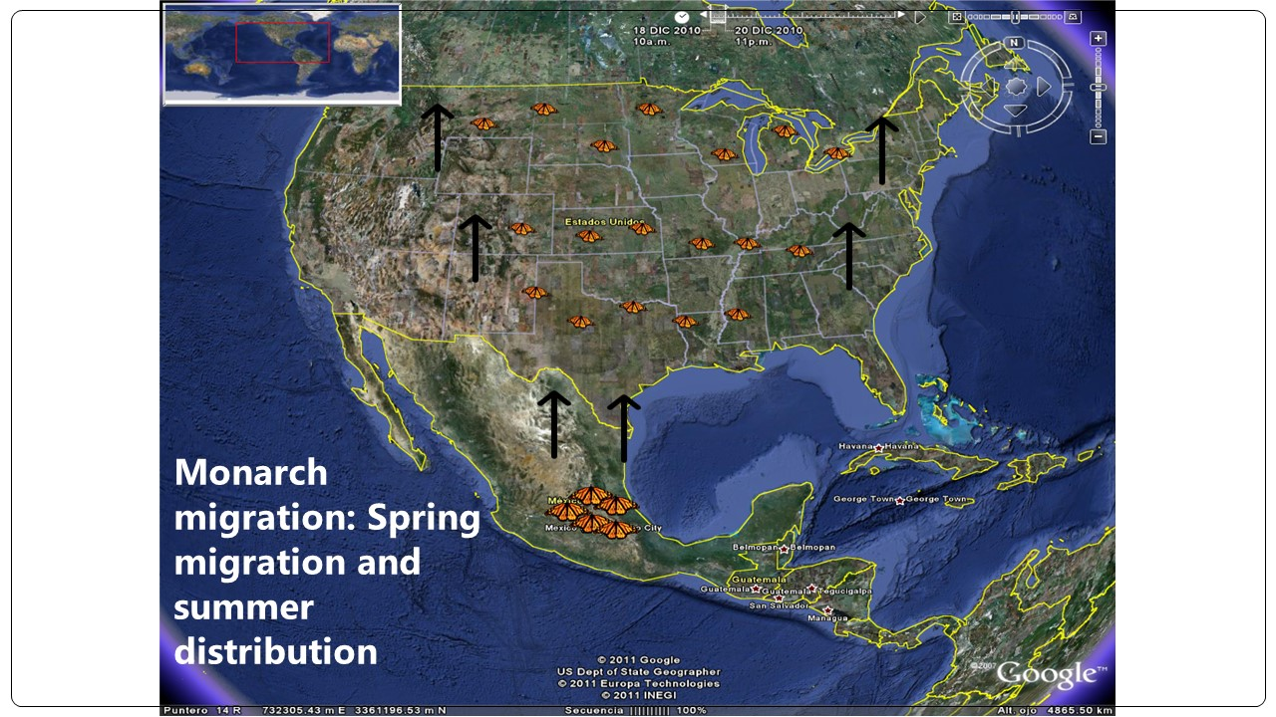

Slide 25
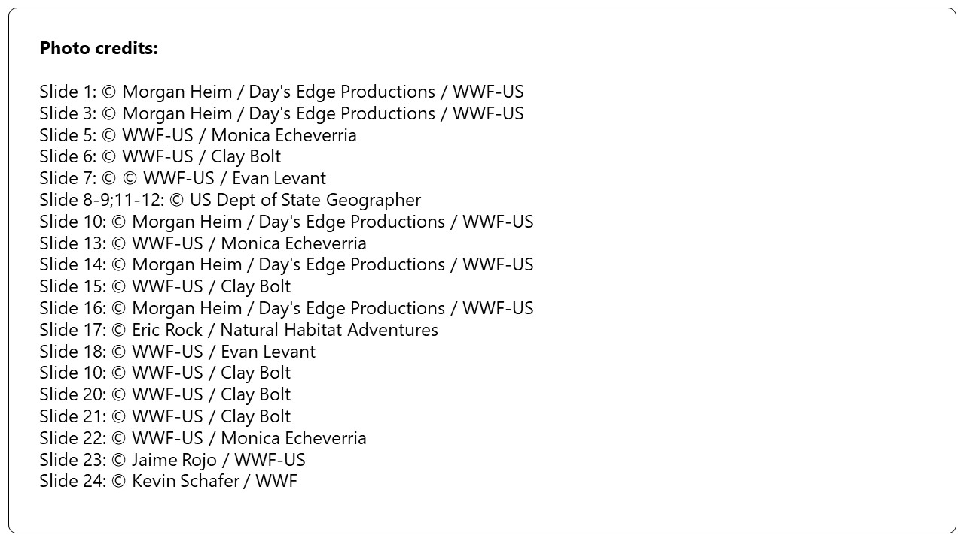

Slide 26
© 2023 WWF. All rights reserved by World Wildlife Fund, Inc. WWF® and ©1986 Panda Symbol are owned by WWF. All rights reserved.

