Slide 1
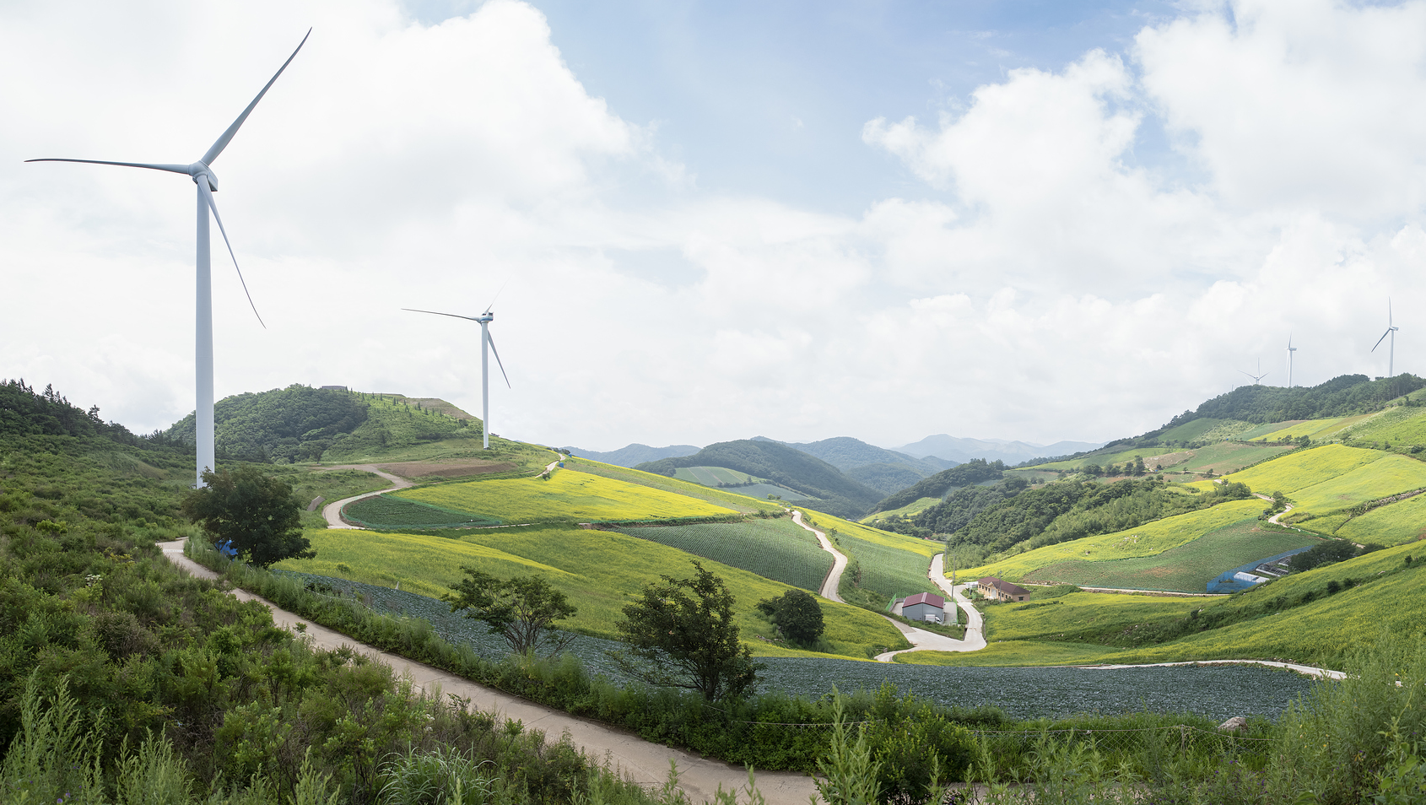
TAKEOVER CHALLENGE:
HOW GREEN CAN YOU GO?
Walkthrough 1
What is sustainability?
© iStock

Slide 2
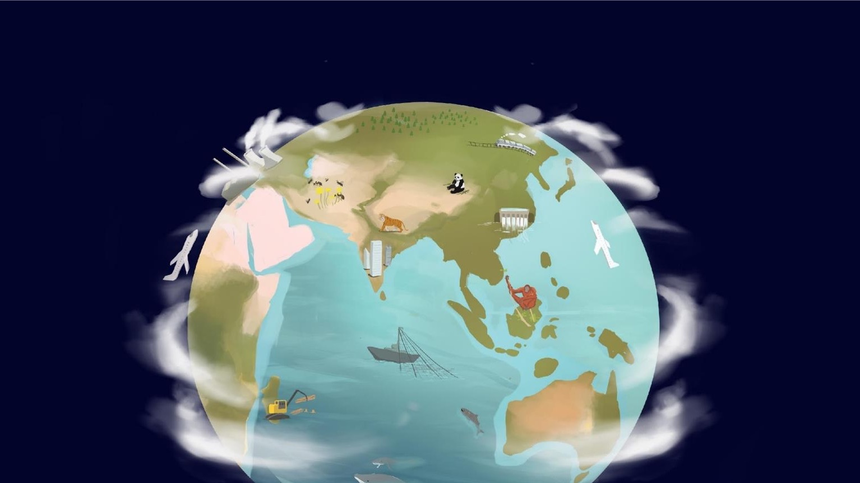
Takeover Challenge: How green can you go?
What does nature give us?

Slide 3
Takeover Challenge: How green can you go?
What does nature give us?
Food
Medicine
Clean water
Wood & paper
Energy
Weather
Beauty
Fun
A home!

Slide 4
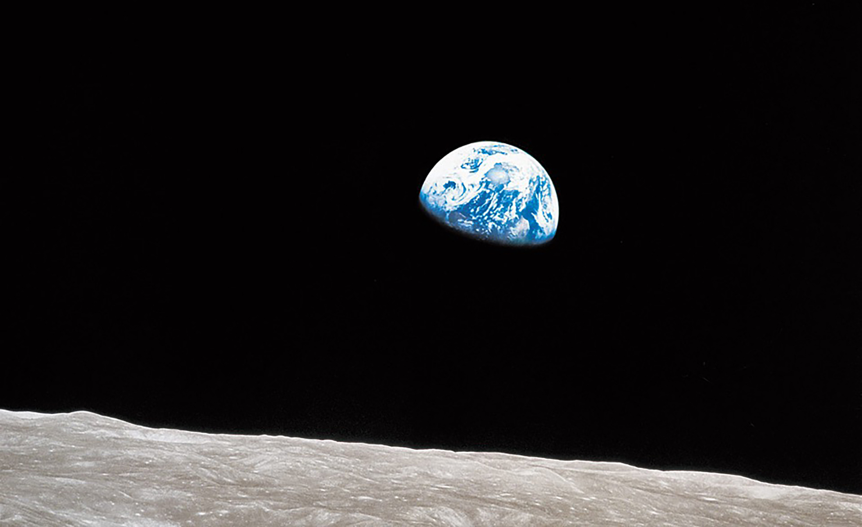
Takeover Challenge: How green can you go?
Bill Anders / NASA / Jim Weigang
What words do you think of when you look at this photo?

Slide 5
Takeover Challenge: How green can you go?
What human activities affect nature?
Farming
Transport
Logging
Fishing
Hunting
Pollution
Buildings/roads
Dams
Climate Change
(Carbon emissions)

Slide 6
Takeover Challenge: How green can you go?
iStock
What might make the pile bigger again?
What happens if we take more than the planet can put back?

Slide 7
Takeover Challenge: How green can you go?
When the amount we take is less or the same as what the planet can replace, we are being ‘sustainable’. That’s because you can ‘sustain’ (carry on) living like that forever.
If you are taking more than the planet can replace, this is ‘unsustainable’ because you cannot carry on forever. The pile will run out.
Sustainable
Sustainable
Unsustainable
© Luis Barreto / WWF-UK and Getty
Natural resources
Human activity

Slide 8
TAKEOVER CHALLENGE:
HOW GREEN CAN YOU GO?
Walkthrough 2
What is a sustainable business?
© iStock

Slide 9
Takeover Challenge: How green can you go?
Sustainability
© Shutterstock
Meeting our own needs without compromising the ability of future generations to meet their needs.

Slide 10
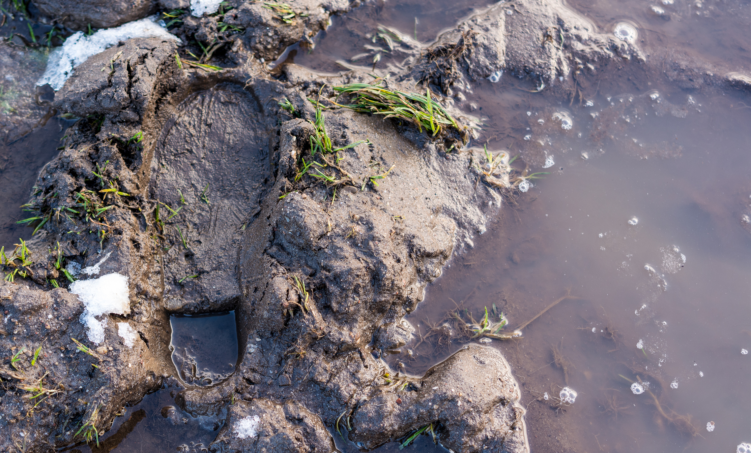
Takeover Challenge: How green can you go?
© iStock
What is a footprint?

Slide 11
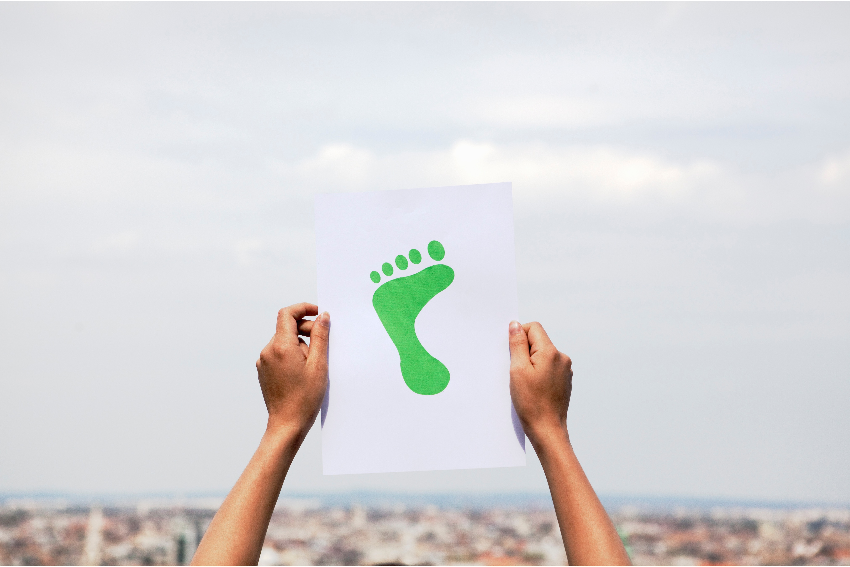
Takeover Challenge: How green can you go?
What things might contribute to our ‘footprint’?
© Getty

Slide 12
Takeover Challenge: How green can you go?
© Getty
Travel
Food
Clothes
Toys

Slide 13
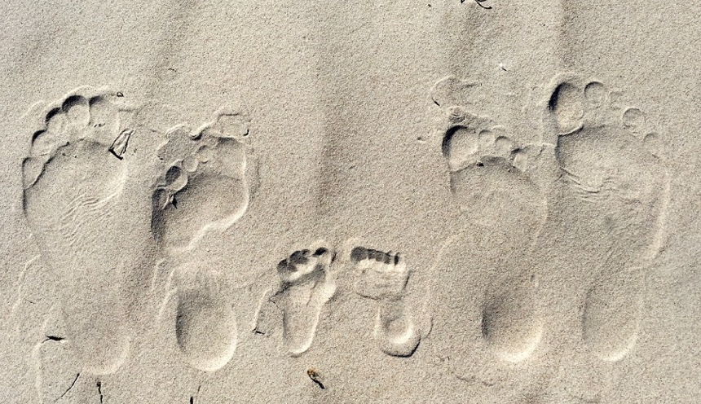
Takeover Challenge: How green can you go?
© Getty
Different
People have different sized footprints

Slide 14
Takeover Challenge: How green can you go?
© Susanna Manu / WWF
Businesses
and organisations have a footprint too

Slide 15
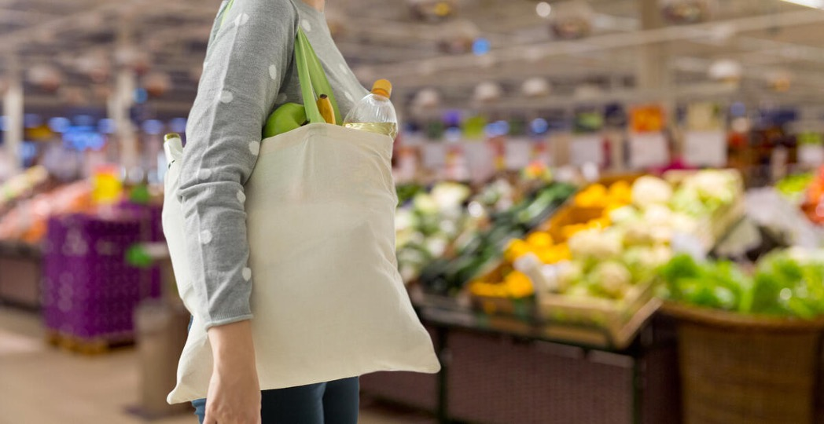
Takeover Challenge: How green can you go?
© Shutterstock
How do businesses affect us?
How can we affect them?

Slide 16
TAKEOVER CHALLENGE:
HOW GREEN CAN YOU GO?
Walkthrough 3
What is greenwashing?
© iStock

Slide 17
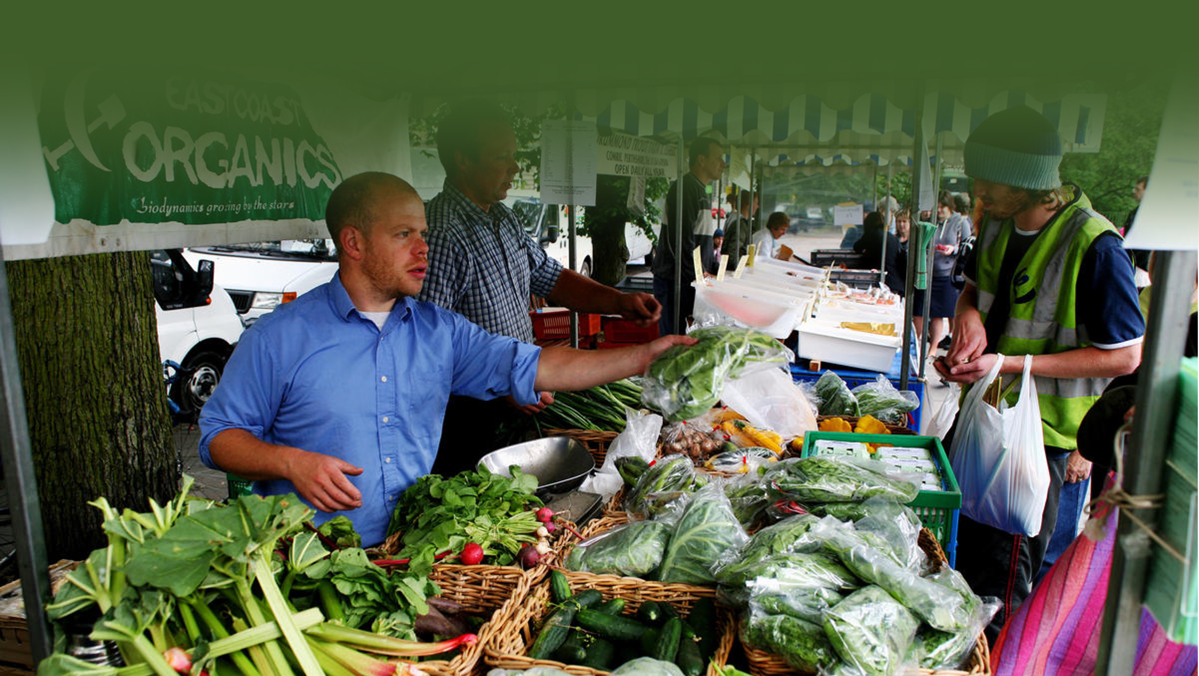
Takeover Challenge: How green can you go?
Businesses and sustainability
© Steve Morgan / WWF-UK
How can we tell if a business is sustainable?
Why might a business make unsustainable choices?
Why might a business want people to think they are sustainable?

Slide 18
Takeover Challenge: How green can you go?
© Luis Barreto / WWF-UK
Greenwashing:
When businesses tell people they are sustainable when they are not

Slide 19
Takeover Challenge: How green can you go?
Challenge: Balls under cups
© Getty

Slide 20
Takeover Challenge: How green can you go?
© Getty
If a company is transparent and allows customers to see everything it does, customers can make informed decisions (and can trust the claims they make about sustainability).

Slide 21
Takeover Challenge: How green can you go?
© iStock
Official
accreditation
and logos
Notes:
Can you find a Cruelty-Free International logo for this page? I can’t find one anywhere

Slide 22
Takeover Challenge: How green can you go?

Slide 23
TAKEOVER CHALLENGE:
HOW GREEN CAN YOU GO?
Contacting businesses
© iStock

Slide 24
Takeover Challenge: How green can you go?
© iStock
What should you think about when choosing a business?

Slide 25
Takeover Challenge: How green can you go?
What should you think about when choosing a business?
Find a business you are interested in
© iStock
Think about businesses that can have the biggest environmental impact
Pick a local business
Think about any connections you might have

Slide 26
Takeover Challenge: How green can you go?
© iStock
What should you do before contacting a business?

Slide 27
Takeover Challenge: How green can you go?
Do some research
© iStock
What should you do before contacting a business?
Think about how the business might be having an environmental impact
Be aware of greenwashing

Slide 28
Takeover Challenge: How green can you go?
© iStock
How should you contact a business?

Slide 29
Takeover Challenge: How green can you go?
Think about how you will get in touch with them
© iStock
Decide who the best person to contact is
How should you contact a business?
Tell your chosen business what the Takeover Challenge is
Be positive about your chosen business when you contact them
Don’t worry if the business doesn’t get back to you straight away
Work with the business to find out the easiest way for them to get involved

