Slide 1
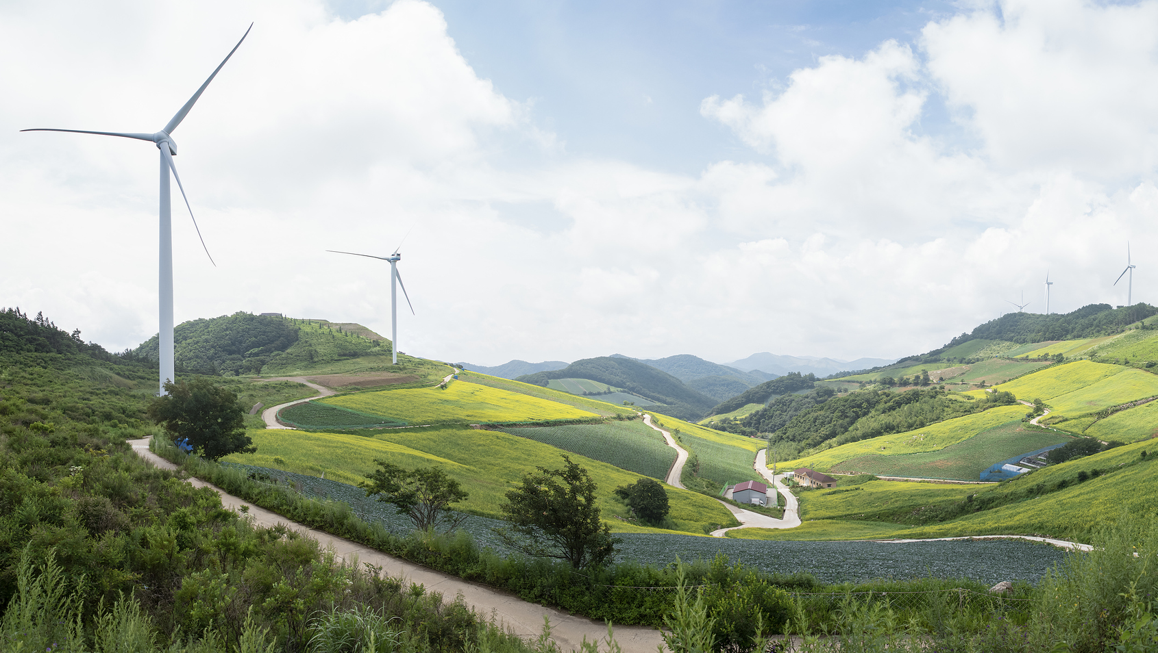
TAKEOVER CHALLENGE:
HOW GREEN CAN YOU GO?
Walkthrough 1
What is sustainability?
© iStock

Slide 2
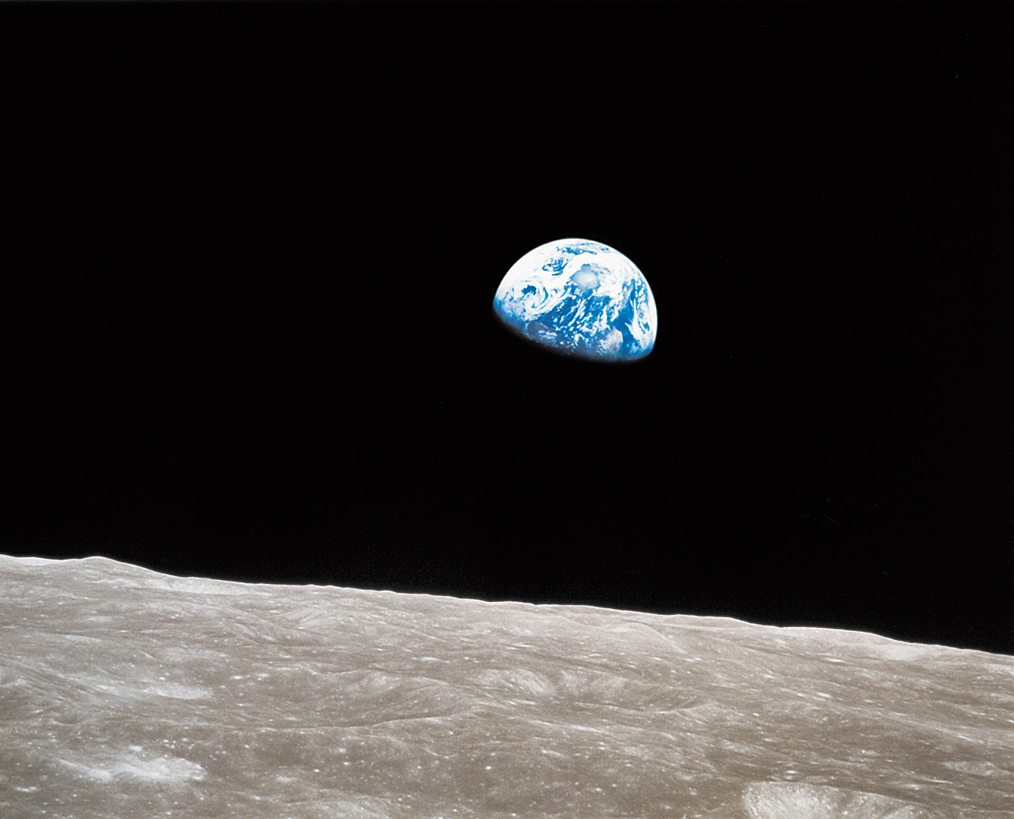
Takeover Challenge: How green can you go?
Bill Anders / NASA / Jim Weigang
What is sustainability?

Slide 3
Takeover Challenge: How green can you go?
Sustainability
Bill Anders / NASA / Jim Weigang
Meeting our own needs without compromising the ability of future generations to meet their needs.

Slide 4
Takeover Challenge: How green can you go?
Sustainability
Bill Anders / NASA / Jim Weigang
Meeting our own needs without compromising the ability of future generations to meet their needs.
What are our needs?
What needs do all humans have?
What are natural resources?

Slide 5
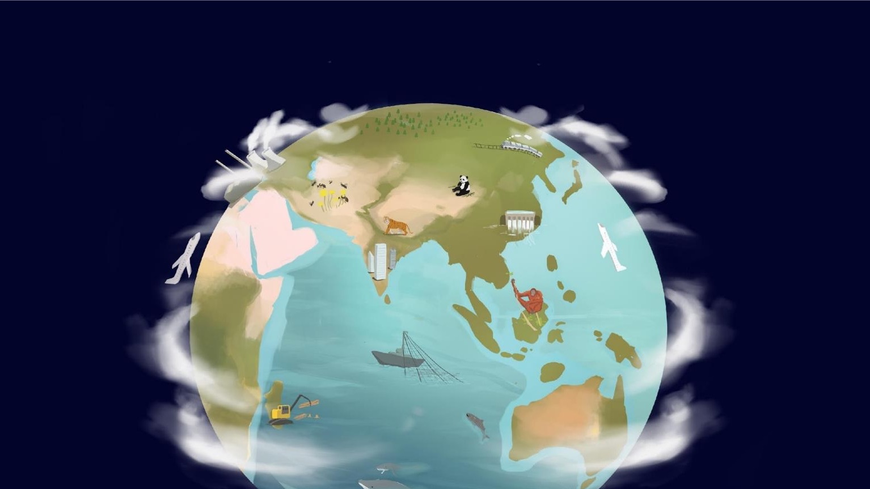
Takeover Challenge: How green can you go?
What impacts on our needs?
Climate change
Deforestation
Intensive farming
Over-fishing
Irresponsible financial investments
Extinction of species

Slide 6
Takeover Challenge: How green can you go?
© Getty
We have
limited
resources
on Earth

Slide 7
Takeover Challenge: How green can you go?
Using scales to represent sustainability
© Luis Barreto / WWF-UK and Getty
Sustainable
Sustainable
Unsustainable
Natural resources
Human activity

Slide 8
Takeover Challenge: How green can you go?
If each side of the scale is balanced or there are more natural resources than human activity, it is sustainable. If humans are taking more natural resources than are available, the scales will be unbalanced which is unsustainable.
© Luis Barreto / WWF-UK and Getty
Sustainable
Sustainable
Unsustainable
Natural resources
Human activity

Slide 9
TAKEOVER CHALLENGE:
HOW GREEN CAN YOU GO?
Walkthrough 2
What is a sustainable business?
© iStock

Slide 10
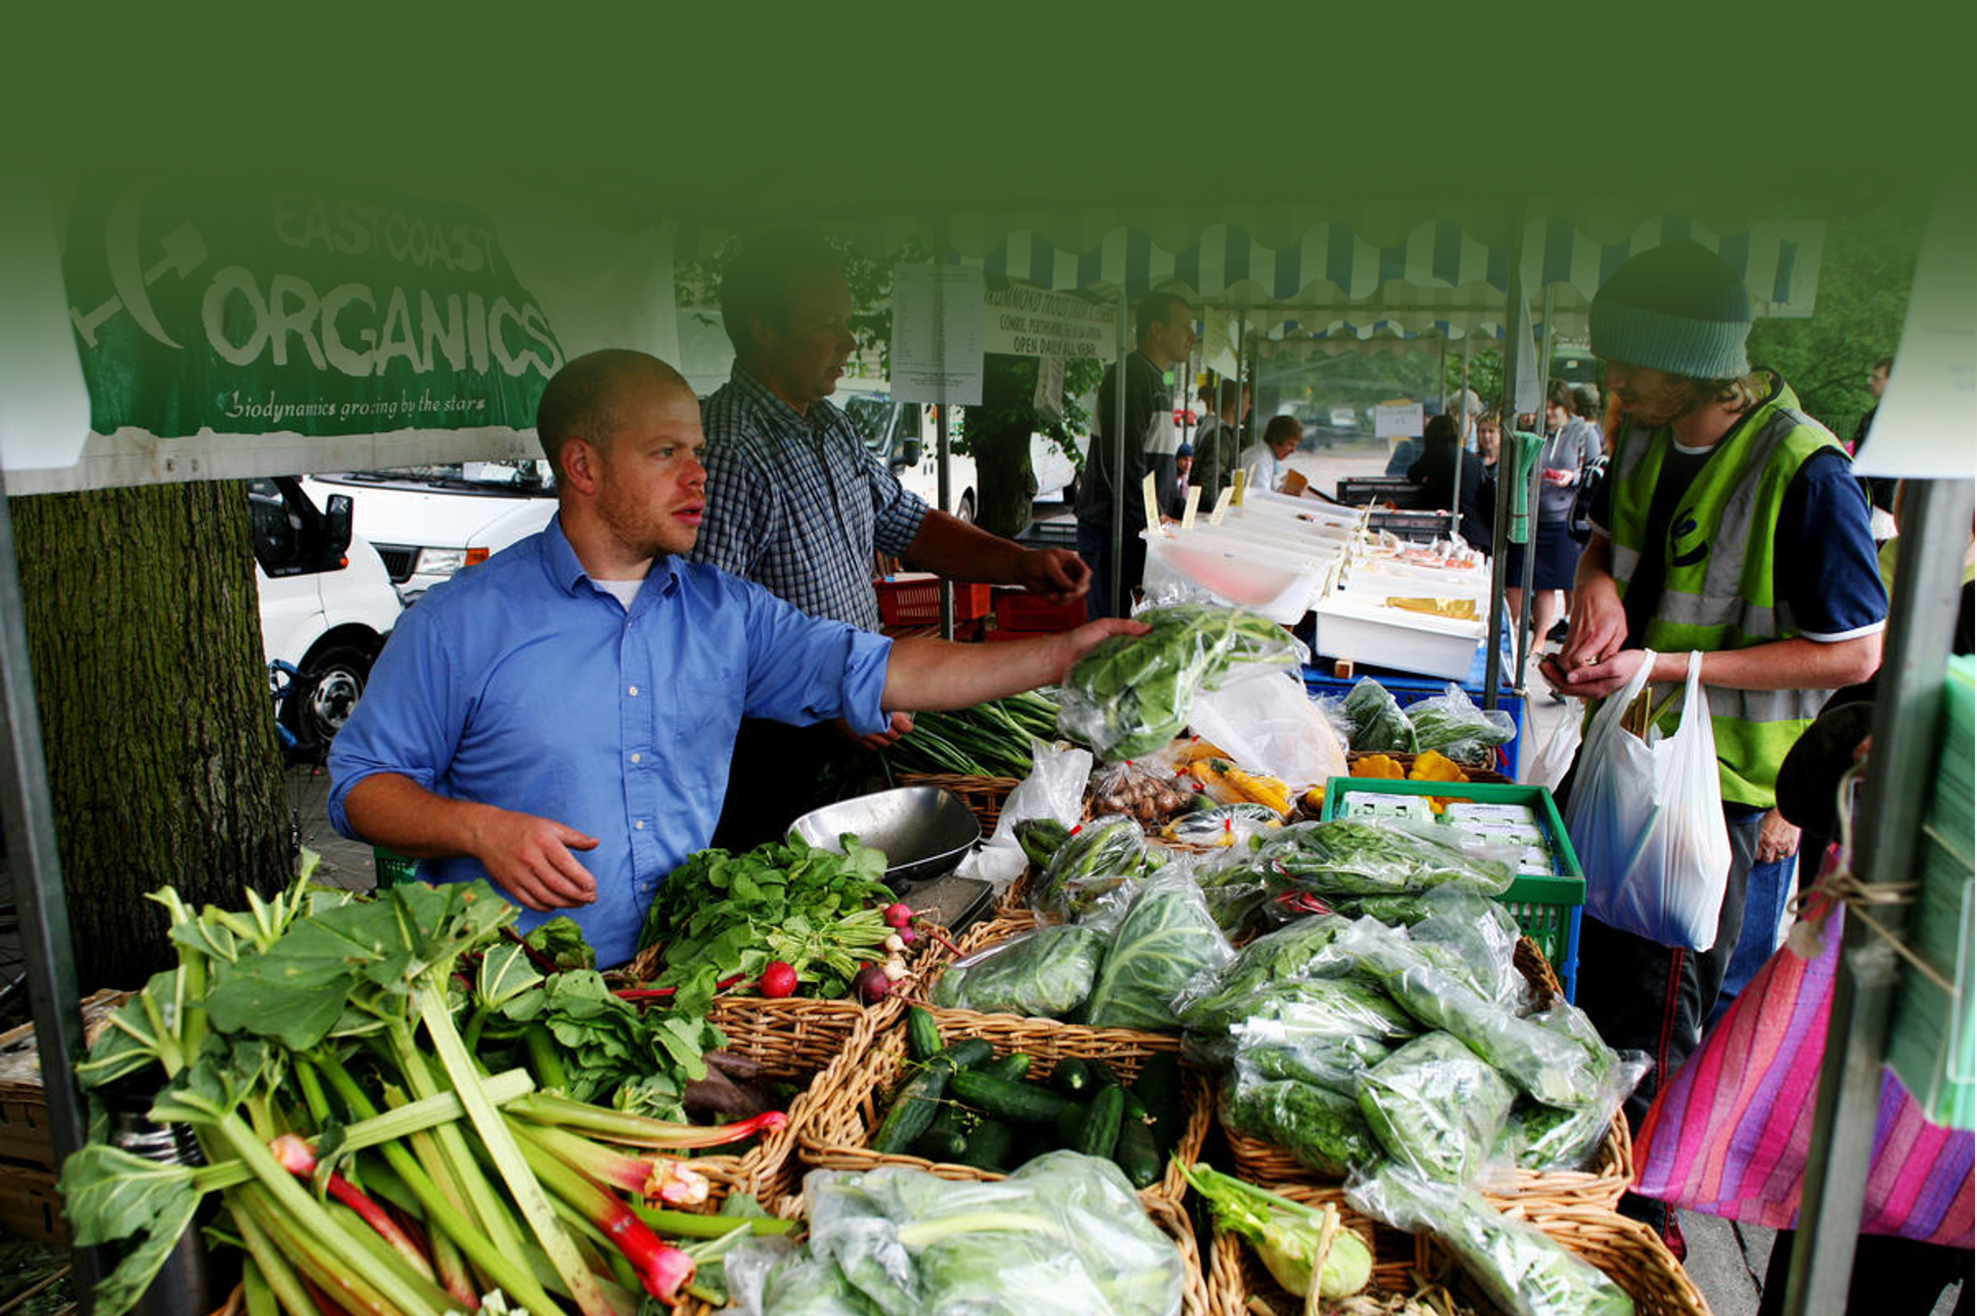
Takeover Challenge: How green can you go?
© Steve Morgan / WWF-UK
What is a
sustainable
business?

Slide 11
Takeover Challenge: How green can you go?
Sustainable business
© Steve Morgan / WWF-UK
A business that makes its products or services without harming the planet or people, now or in the future.

Slide 12
Takeover Challenge: How green can you go?
© Shutterstock
Why is it important for businesses
to be
sustainable?

Slide 13
Takeover Challenge: How green can you go?
Why is it important for businesses to be sustainable?
© Shutterstock
Business is at the heart of a sustainable future. It is even more important for businesses to be sustainable than individuals as they are on a bigger scale.

Slide 14
Takeover Challenge: How green can you go?
What are…
© Getty

Slide 15
Takeover Challenge: How green can you go?
© Getty
Values are the things we consider to be most important. They are principles that guide our choices.

Slide 16
Takeover Challenge: How green can you go?
© iStock
Businesses can also value
sustainability

Slide 17
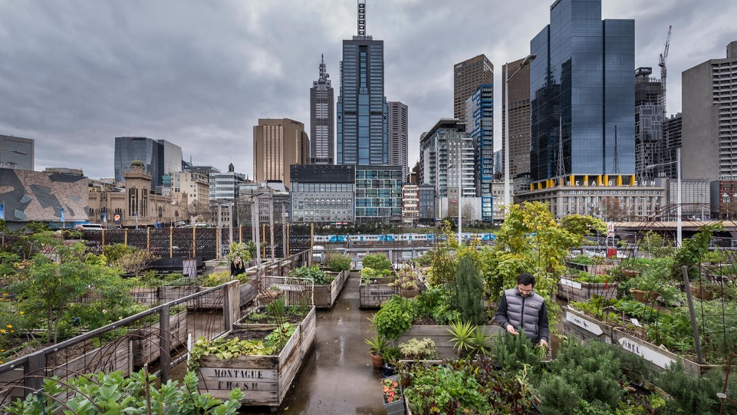
Takeover Challenge: How green can you go?
Task: Come up with some of your own sustainability business values
© naturepl.com / Doug Gimesy / WWF

Slide 18
TAKEOVER CHALLENGE:
HOW GREEN CAN YOU GO?
Walkthrough 3
What is greenwashing?
© iStock

Slide 19
Takeover Challenge: How green can you go?
© Shutterstock
How do we know if a business is sustainable?
Why might a business falsely claim to be sustainable?

Slide 20
Takeover Challenge: How green can you go?
© Luis Barreto / WWF-UK
What is
greenwashing?

Slide 21
Takeover Challenge: How green can you go?
© Luis Barreto / WWF-UK
Greenwashing:
When a business claims to be more sustainable than it actually is

Slide 22
Takeover Challenge: How green can you go?
How can we know if a business is sustainable?
© iStock
Official
accreditation
and logos
Notes:
Can you find a Cruelty-Free International logo for this page? I can’t find one anywhere

Slide 23
Takeover Challenge: How green can you go?

Slide 24
TAKEOVER CHALLENGE:
HOW GREEN CAN YOU GO?
Contacting businesses
© iStock

Slide 25
Takeover Challenge: How green can you go?
© iStock
What should you think about when choosing a business?

Slide 26
Takeover Challenge: How green can you go?
What should you think about when choosing a business?
Find a business you are interested in
© iStock
Think about businesses that can have the biggest environmental impact
Pick a local business
Think about any connections you might have

Slide 27
Takeover Challenge: How green can you go?
© iStock
What should you do before contacting a business?

Slide 28
Takeover Challenge: How green can you go?
Do some research
© iStock
What should you do before contacting a business?
Think about how the business might be having an environmental impact
Be aware of greenwashing

Slide 29
Takeover Challenge: How green can you go?
© iStock
How should you contact a business?

Slide 30
Takeover Challenge: How green can you go?
Think about how you will get in touch with them
© iStock
Decide who the best person to contact is
How should you contact a business?
Tell your chosen business what the Takeover Challenge is
Be positive about your chosen business when you contact them
Don’t worry if the business doesn’t get back to you straight away
Work with the business to find out the easiest way for them to get involved

